Slide 1

Files

Slide 2
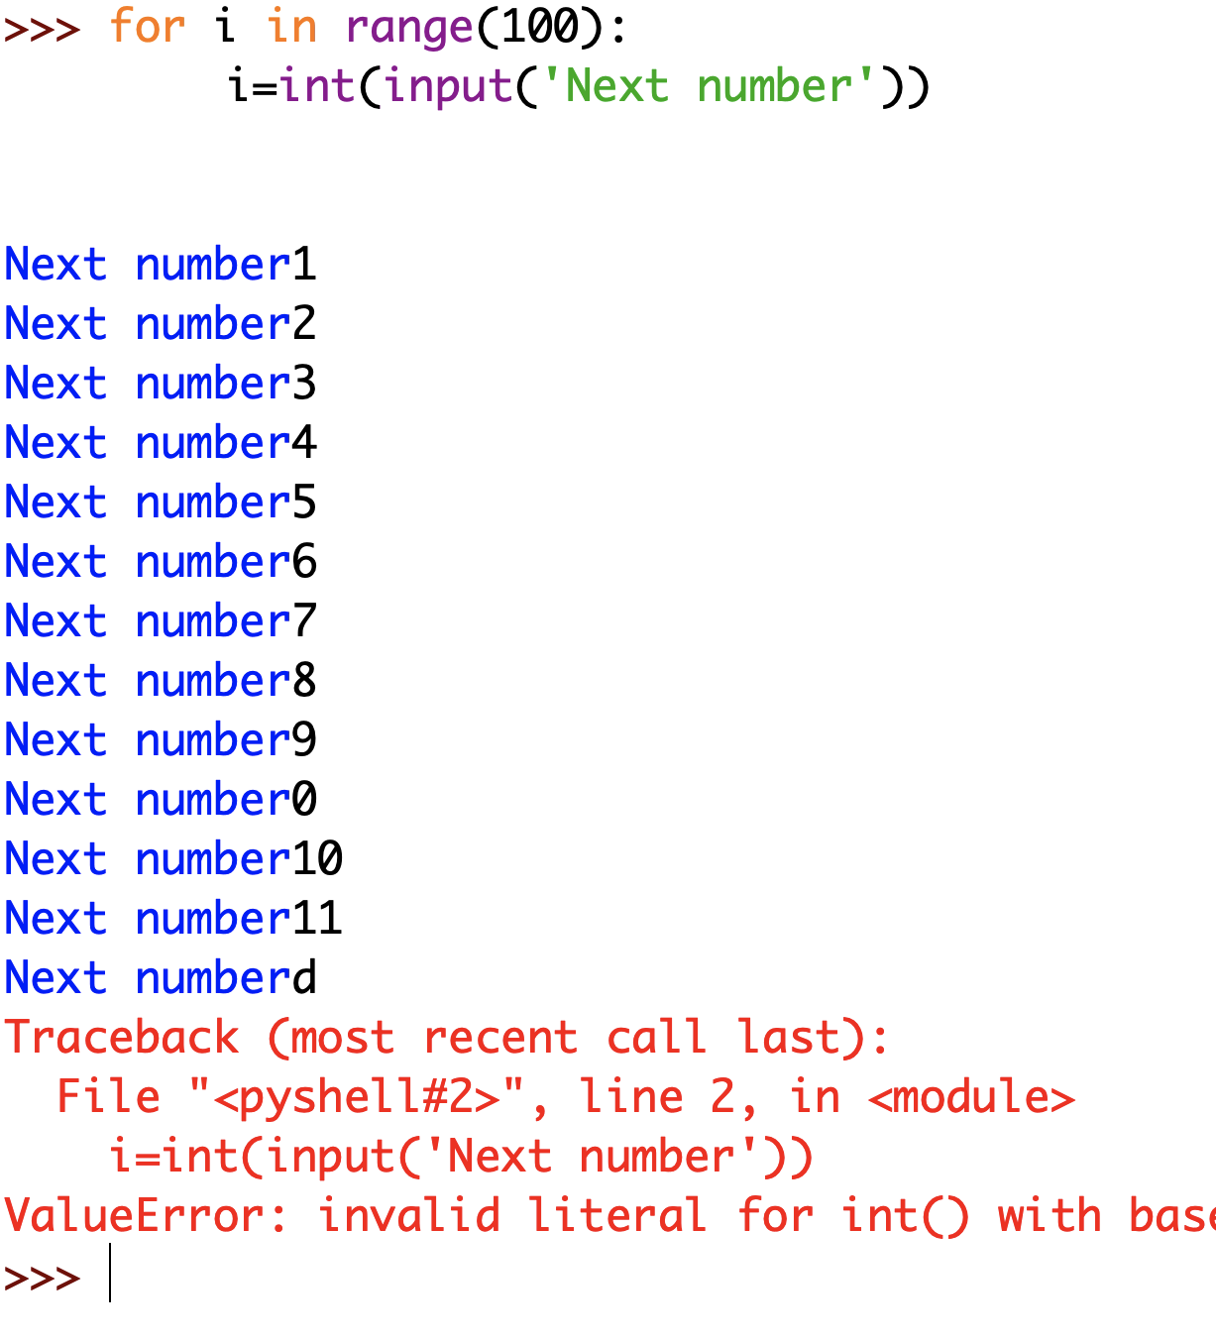
Keyboard I/O

Slide 3
File?
A file is the "container" for keeping data
Can have small or huge amount of data
Can be created, accessed and used by a computer program.
Durable and persistent
Kept in secondary storage
Unique name/path required for using the files
Basic operations involve open, read, write, append, close etc.

Slide 4

How to?
Generally
Open
Read(if file is an input source)
Process
Optionally write/append(if file is an output)
Close

Slide 5
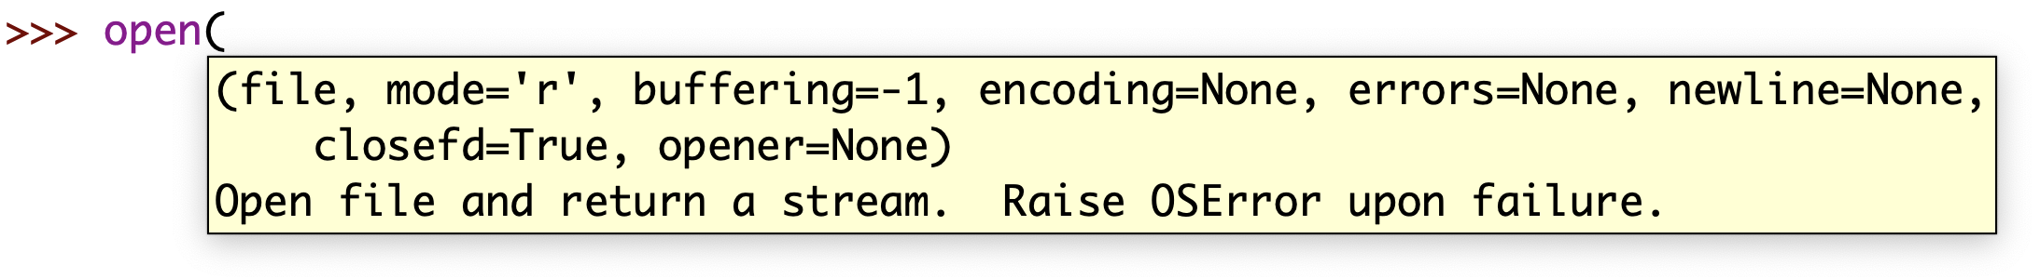
Read
Tell Python that we want to read from a file. How? ➔open function
Has many parameters but two of them are important
First parameter is the name of the file
Second parameter is mode and by default r for reading

Slide 6
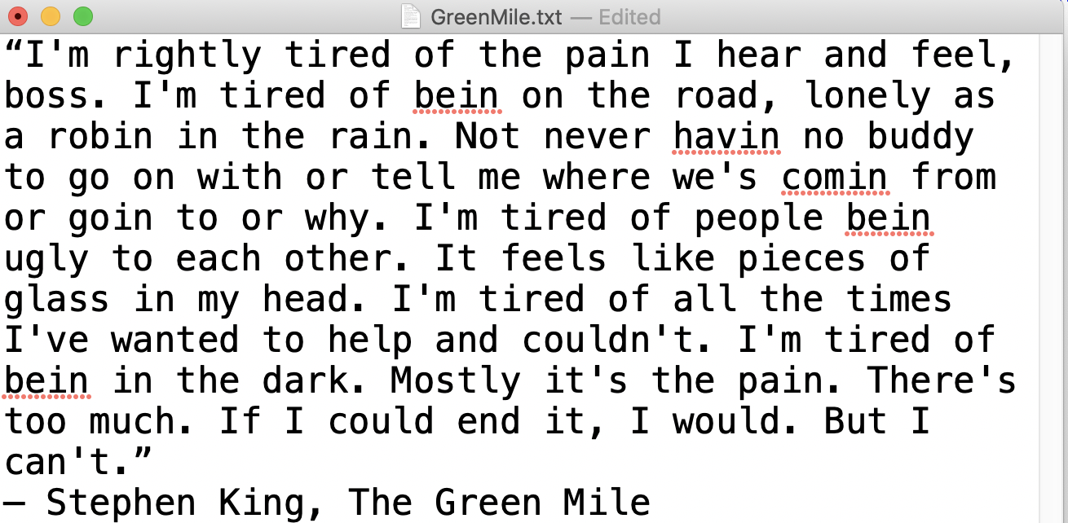
Read a file
Assume that we have a text file whose name is ‘GreenMile.txt’
gm=open('GreenMile.txt’)
OR
gm=open('GreenMile.txt’,’r’)
opens the file
The open() function returns a file object, which offers attributes and methods.
Full path names can also be specifed, as in open('C:\\zorhan\\GreenMile.txt')

Slide 7
Close a file
Assume that we have a text file whose name is ‘GreenMile.txt’
gm=open('GreenMile.txt’)
...
gm.close()

Slide 8
Change the file so each sentence is a line(11 lines)
“I'm rightly tired of the pain I hear and feel, boss.
I'm tired of bein on the road, lonely as a robin in the rain.
Not never havin no buddy to go on with or tell me where we's comin from or goin to or why.
I'm tired of people bein ugly to each other.
It feels like pieces of glass in my head.
I'm tired of all the times I've wanted to help and couldn't.
I'm tired of bein in the dark. Mostly it's the pain.
There's too much.
If I could end it, I would.
But I can't.”
― Stephen King, The Green Mile

Slide 9

Useful methods
rstrip(): strips off whitespaces (newlines included) from the right side of a string
read(): returns the file contents as a string.
readlines(): returns a list of strings, where each element is the lines of the file
Both methods can be given an optional argument that specifies the number of bytes to read from the file.
They stop reading when the end-of-file (EOF) is detected
readline(): returns a single line at a time, which is useful when dealing with large files where the entire file contents may not fit into the available system memory.

Slide 10
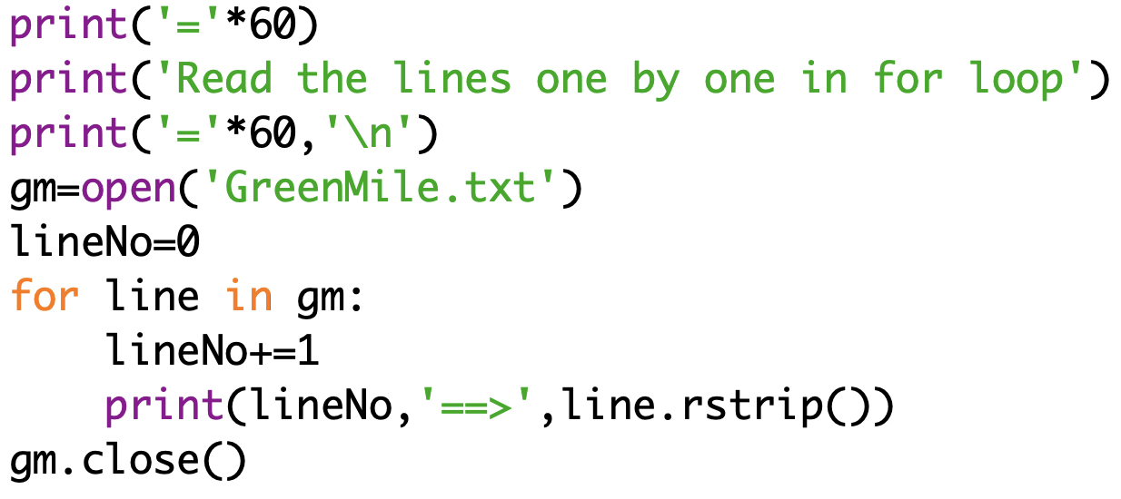
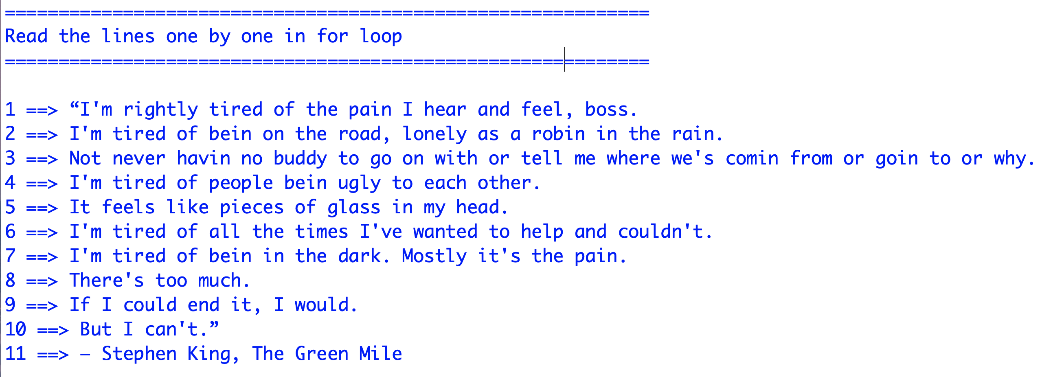
Processing the file: Read operations

Slide 11
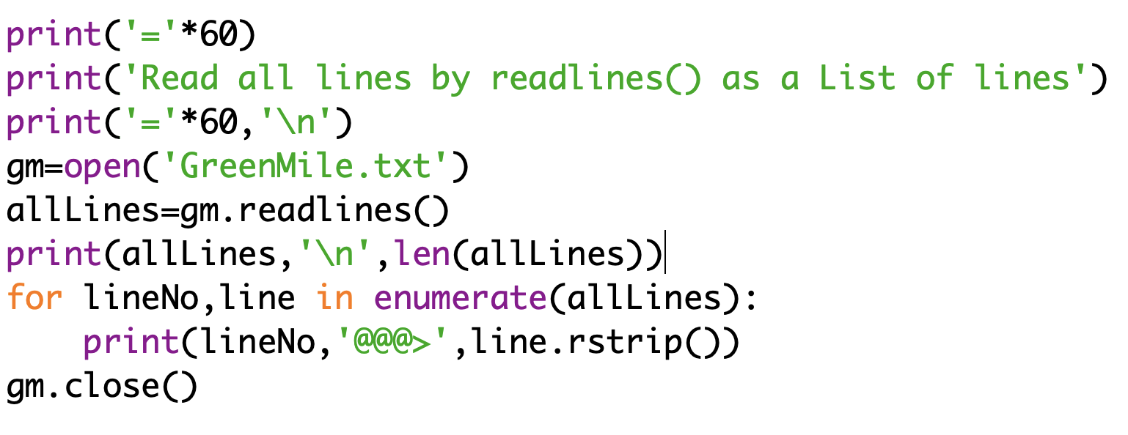
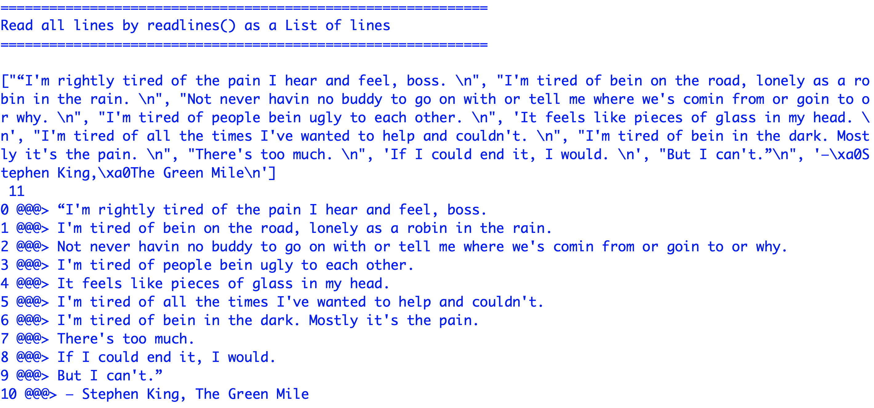
Processing the file: readlines()

Slide 12
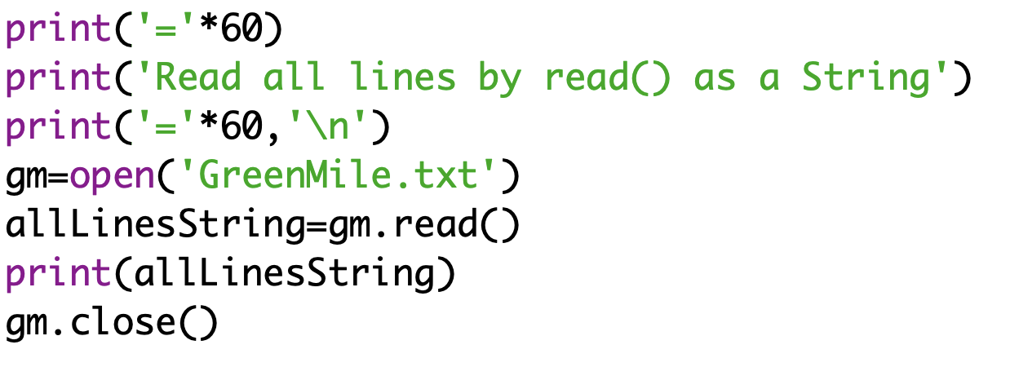
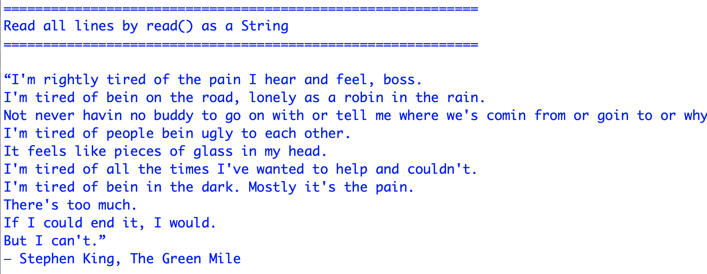
Processing the file: read()

Slide 13
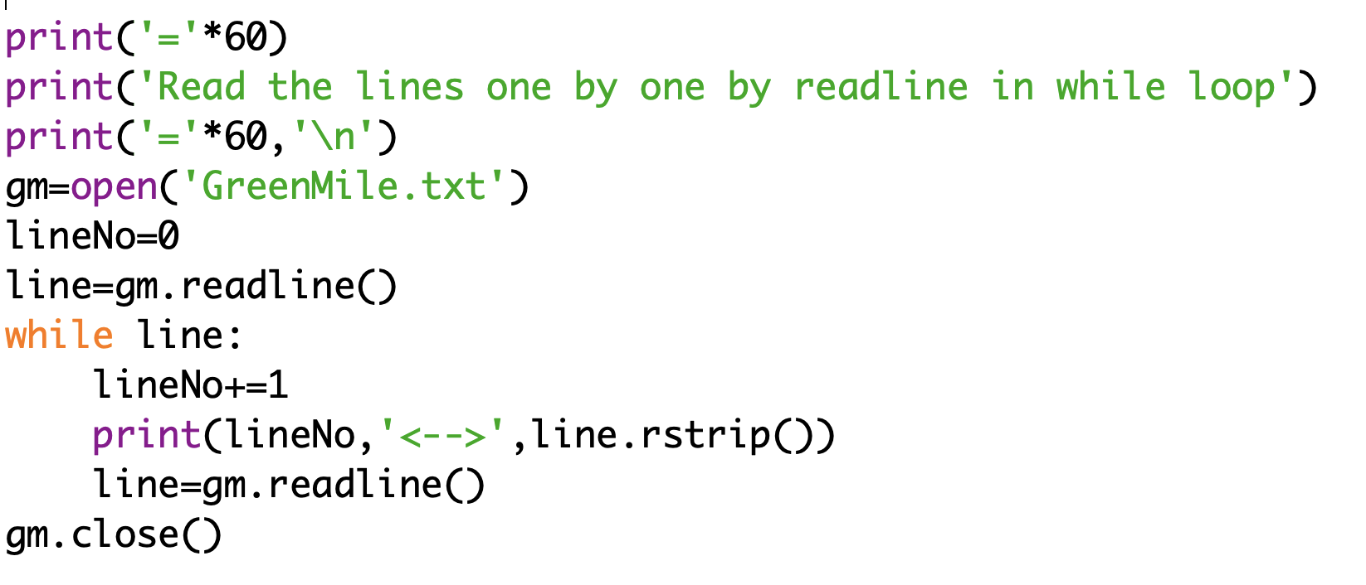
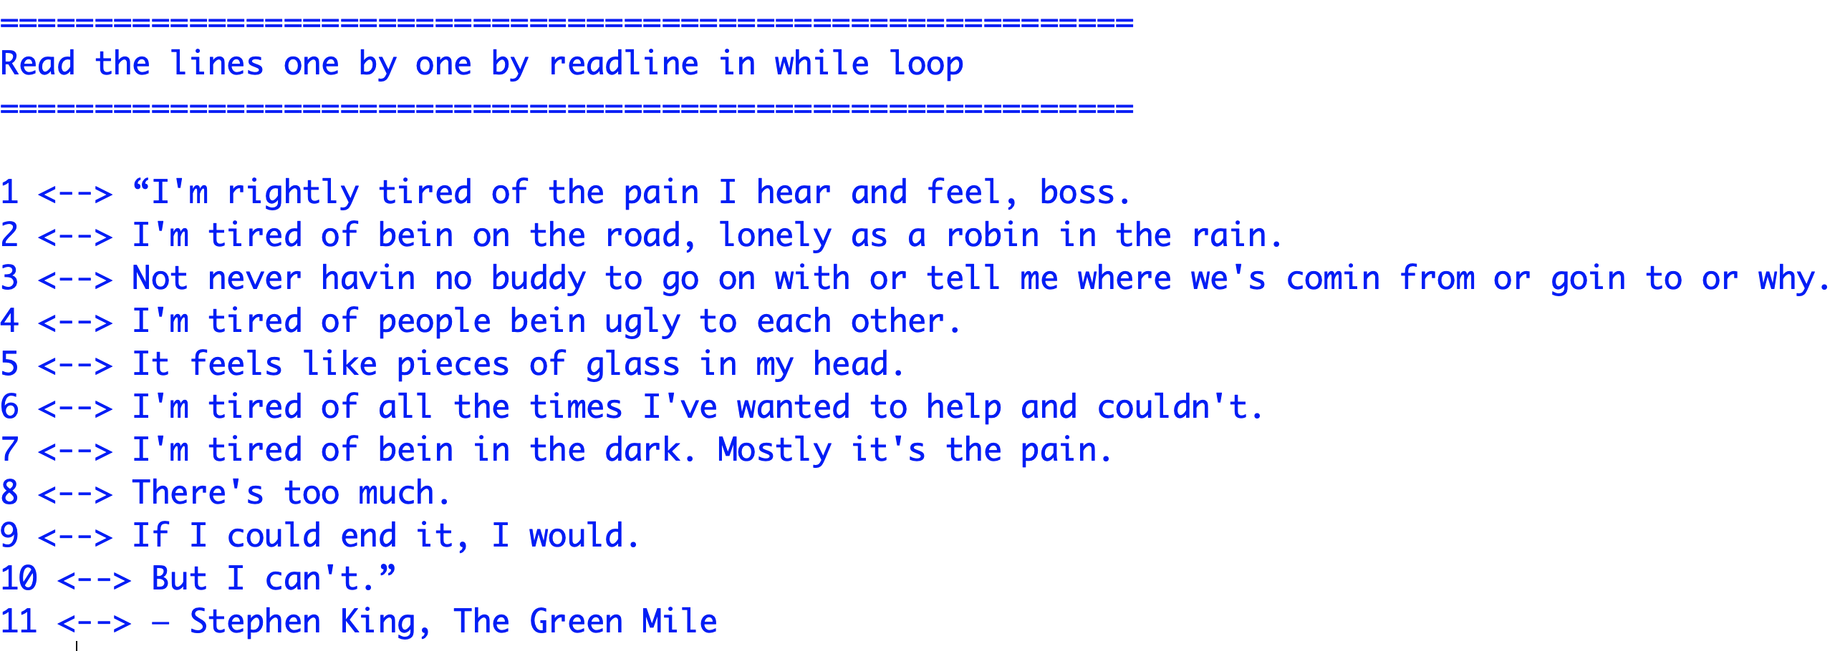
Processing the file: readline()

Slide 14
Write
Tell Python that we want to write to a file. How? ➔open function first but mode is different
Has many parameters but two of them are important
First parameter is the name of the file
Second parameter is mode and w for writing

Slide 15
Write to a file
set the second parameter to "w" instead of "r"
qm=open(‘quotes.txt’,’w’)
opens the file for writing
write() method of file handle object to write the content.
If the file exists, it will delete the old content. BE CAREFULL!!
write() method accepts a string argument only
Other values must first be converted using str()
Do not forget to close the file especially after a write
Not closing the file may have serious consequences: Inconsistent state of your data
with can help: closes automatically after with block

Slide 16
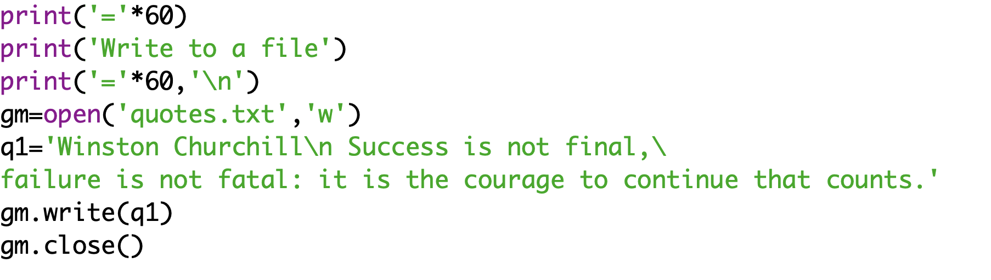
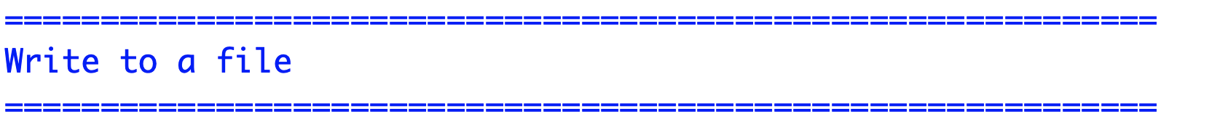
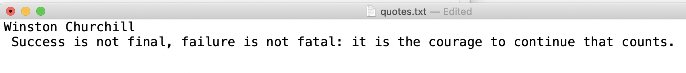
Processing the file: write()

Slide 17
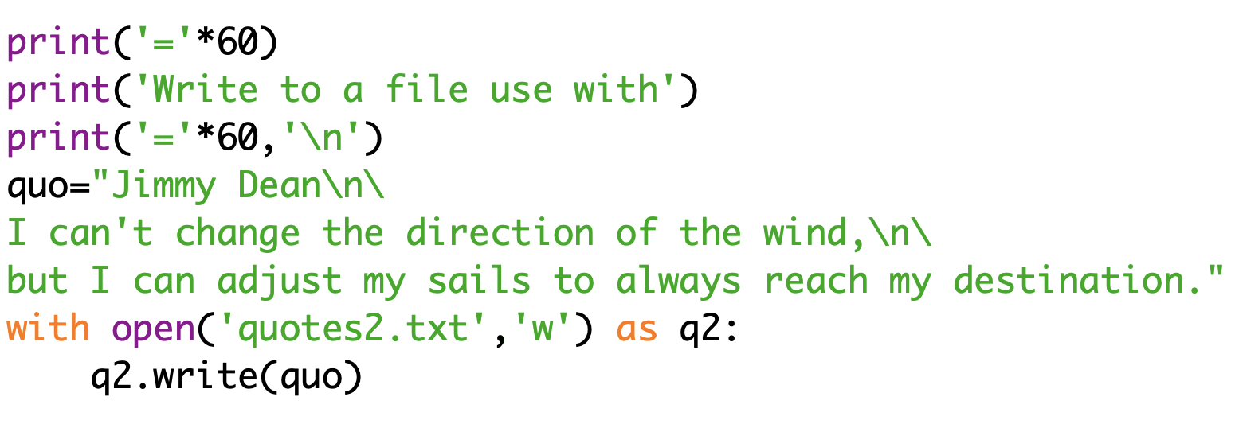
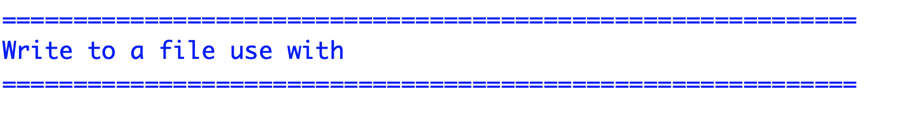
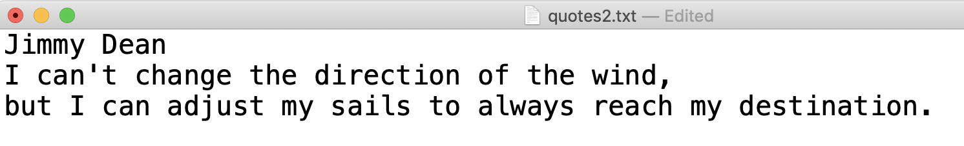
Processing the file: write() and with

Slide 18
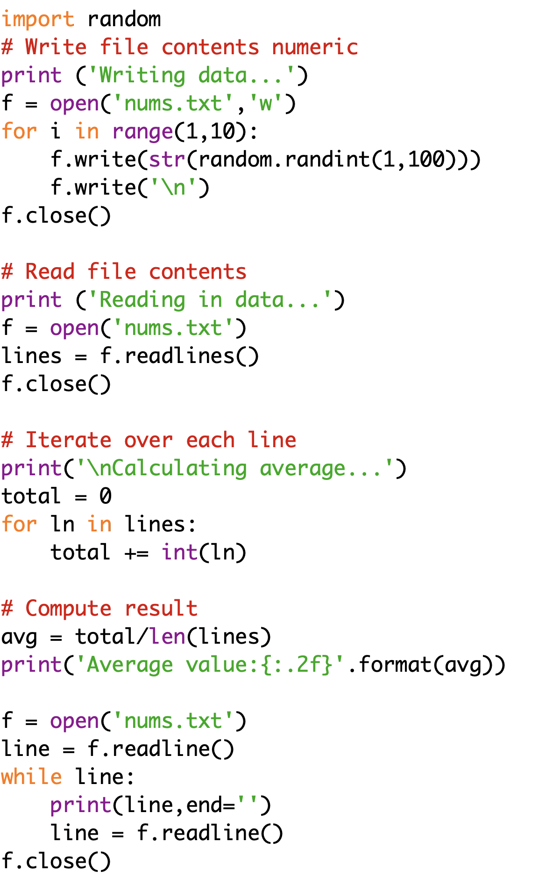
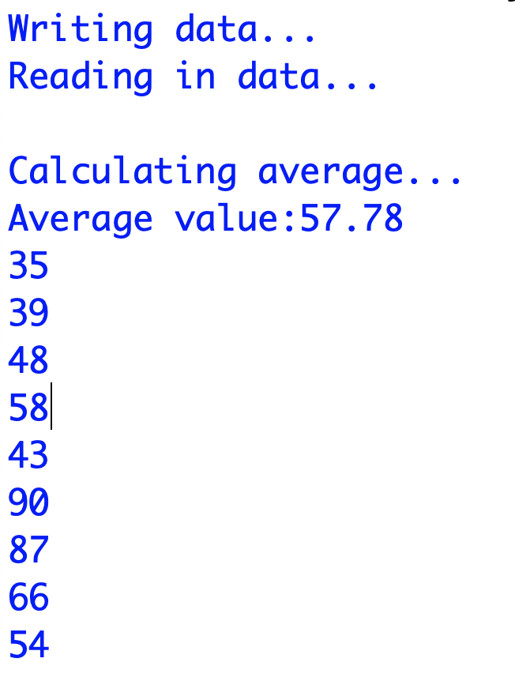
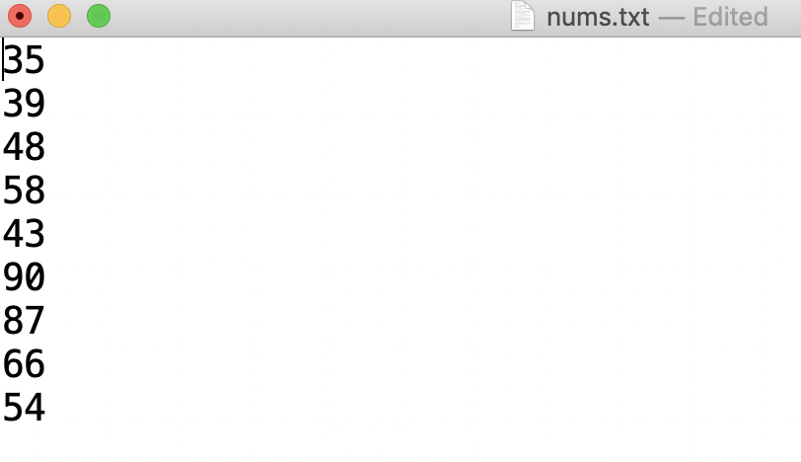
Processing the file: read and write simultaneously and numeric data

Slide 19
Append
Tell Python that we want to append to a file. How? ➔open function first but mode is different
Has many parameters but two of them are important
First parameter is the name of the file
Second parameter is mode and a for appending

Slide 20

Append to a file
set the second parameter to ”a" instead of "r” or ”w”
qm=open(‘quotes.txt’,’a’)
opens the file for appending
If the file exists in w mode it will delete the old content. BE CAREFULL!!!
If
you intentionally want to delete
or
the data in that file is not important
or
you have a backup
use w mode
elif you want to add new data
use a mode
else
SORRY DATA PASSED AWAY RIP ☹

Slide 21
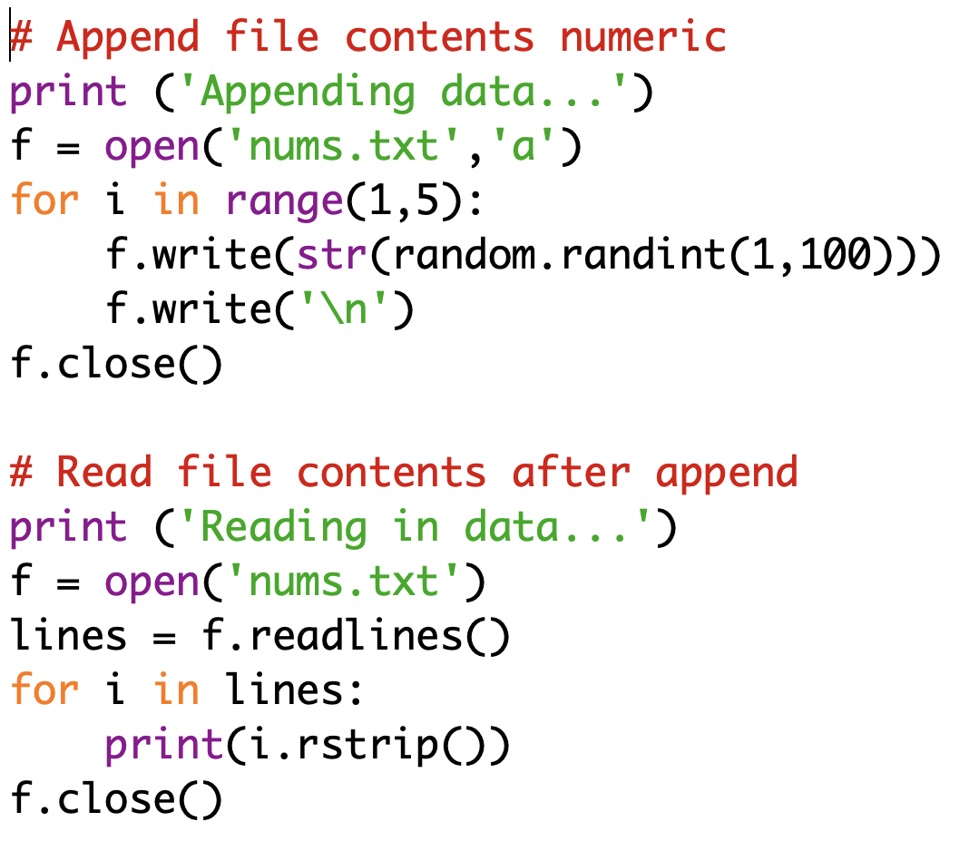
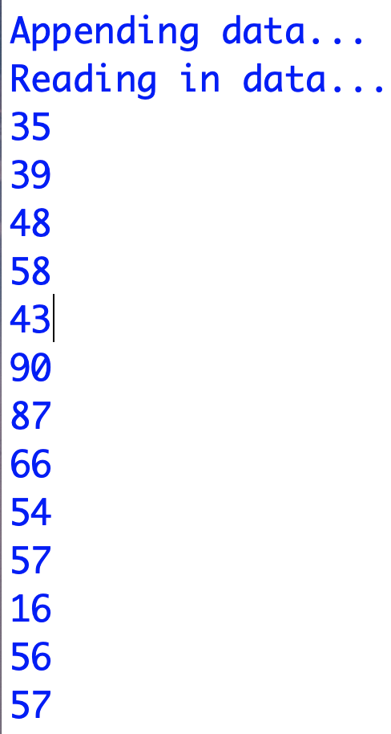
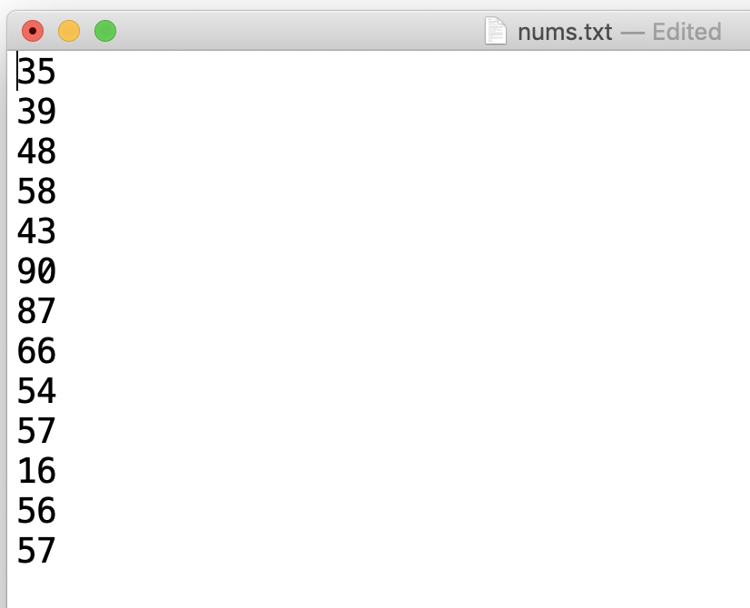
Processing the file: write()

Slide 22
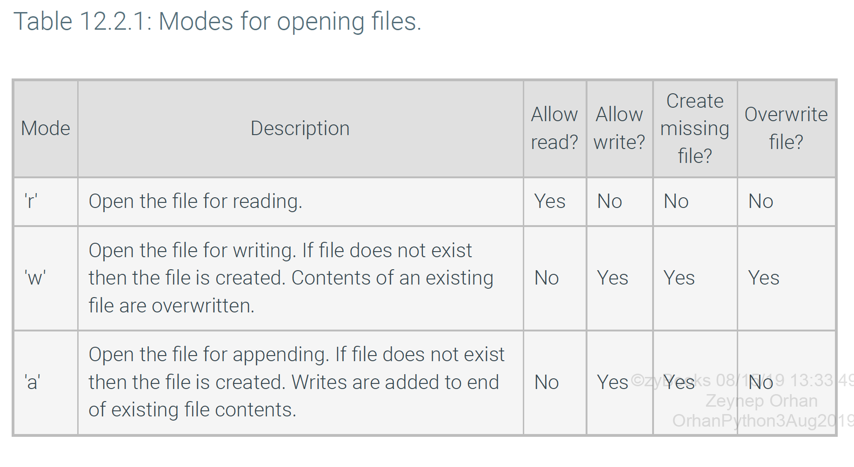

Slide 23
Modes
Read
Read mode 'r' opens a file for reading.
If the file is missing, then an error will occur.
Write
Write mode 'w' opens a file for writing.
If the file is missing, then a new file is created.
Contents of any existing file are overwritten.
Append
Append mode 'a' opens a file for writing.
If the file is missing, then a new file is created.
Writes to the file are appended to the end of an existing file's contents.
Update
Additionally, a programmer can add a '+' character to the end of a mode, like 'r+' and 'w+' to specify an update mode.
Update modes allow for both reading and writing of a file at the same time.

Slide 24
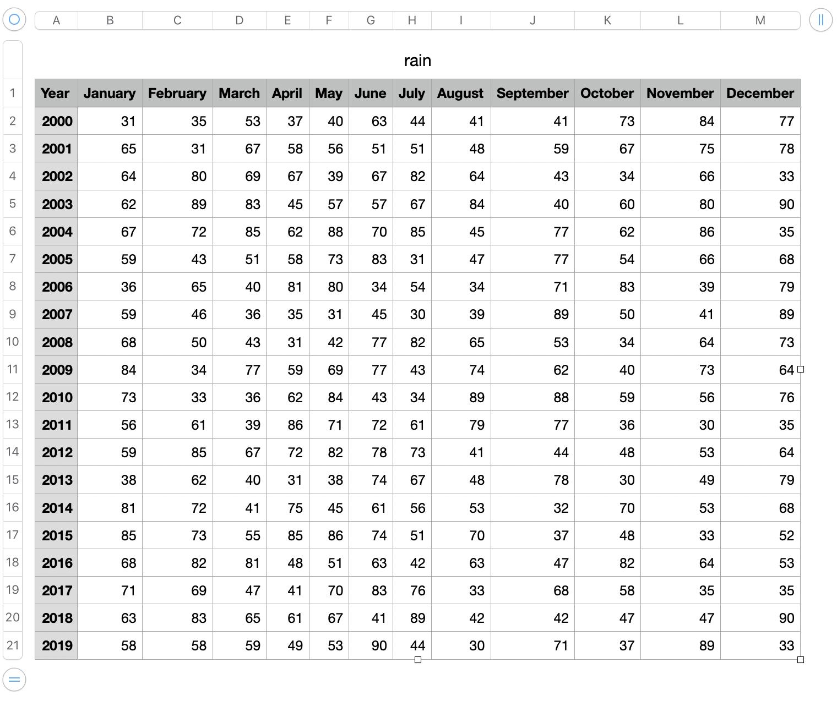
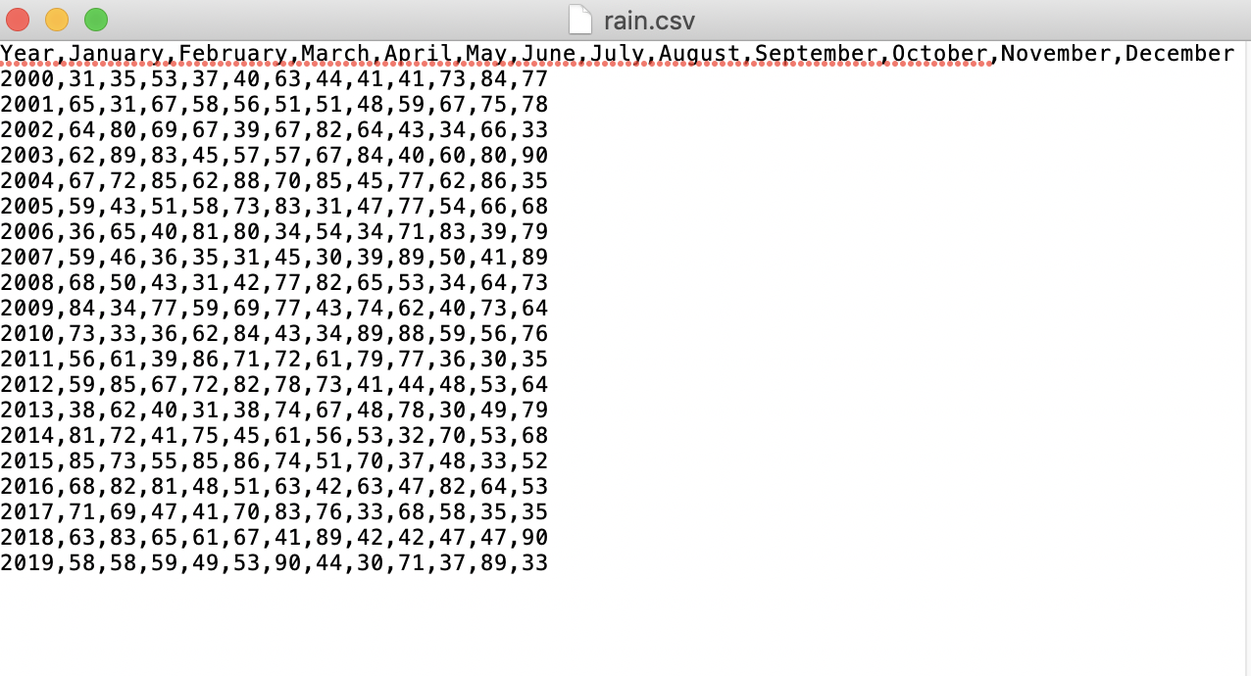
csv files
Many text data kept as comma separated values files(csv)
Has rows and columns
Data items are separated by comma (but others possible)
Use csv module

Slide 25
csv files
create a reader object, pass a file object created via open.
Iterating over the reader using a for loop
Returns each row of the csv file as a list of strings, where each item in the list is a field from the row.
Use the csv module to write text into a csv file, using a writer object.
The writer object’s
writerow() and writerows()
methods can be used to write a list of strings as one or more rows.

Slide 26
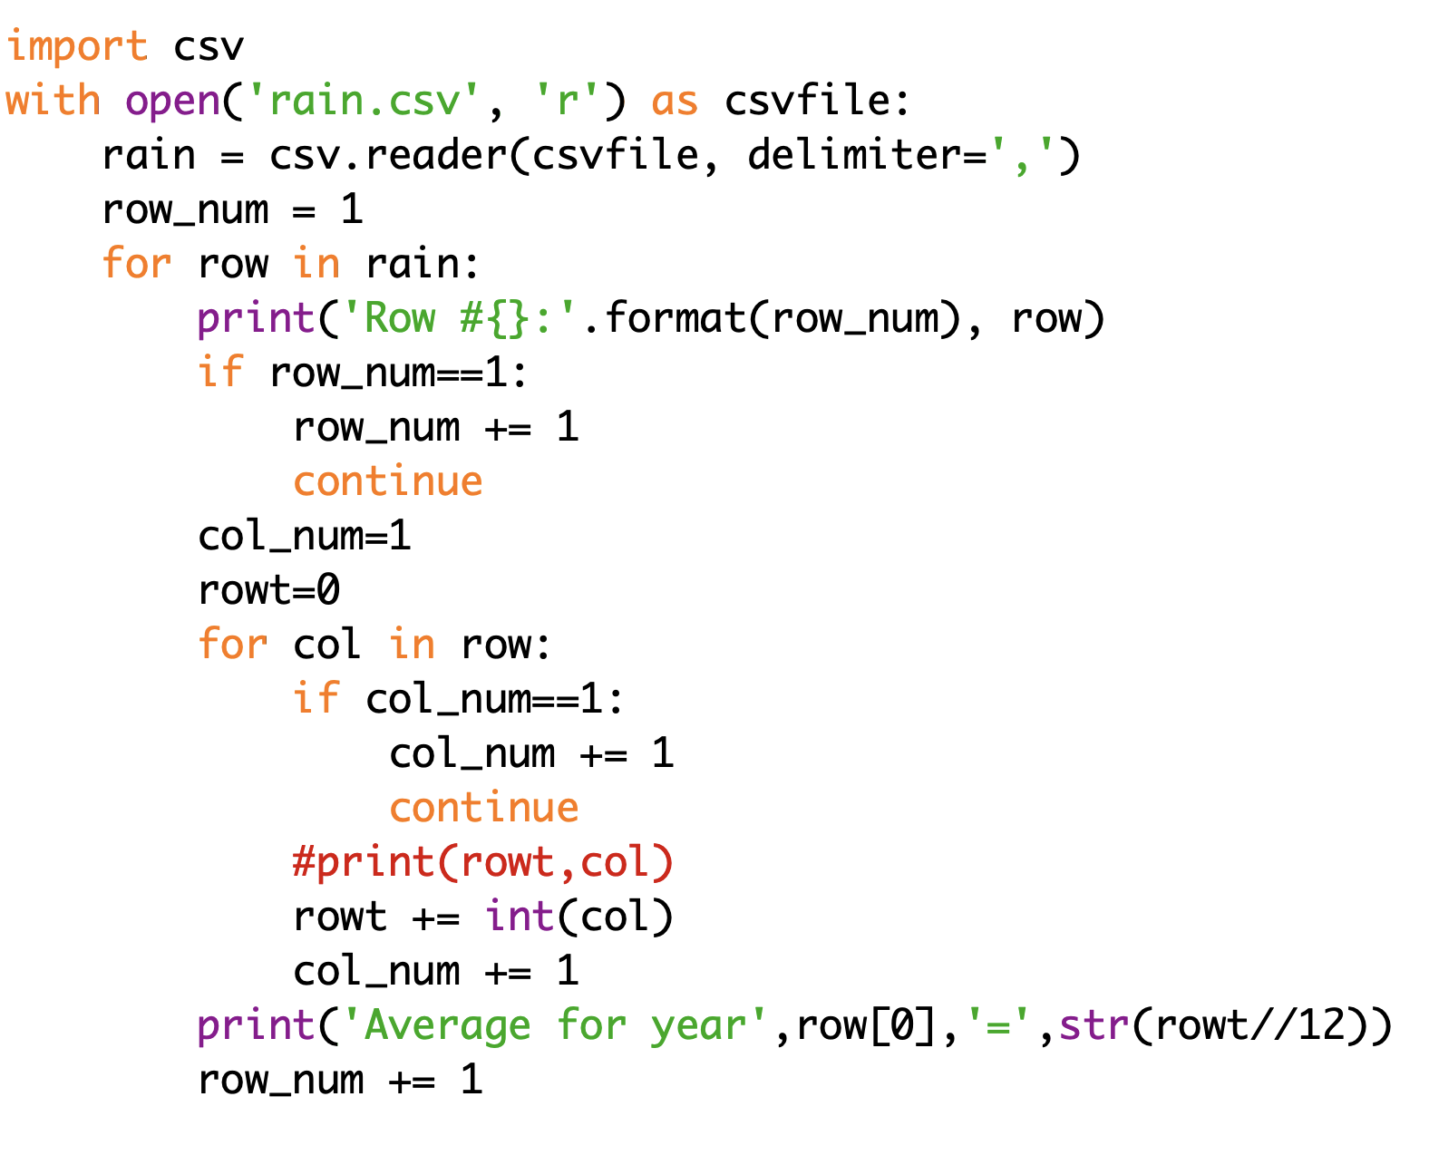
Processing the file: csv read

Slide 27
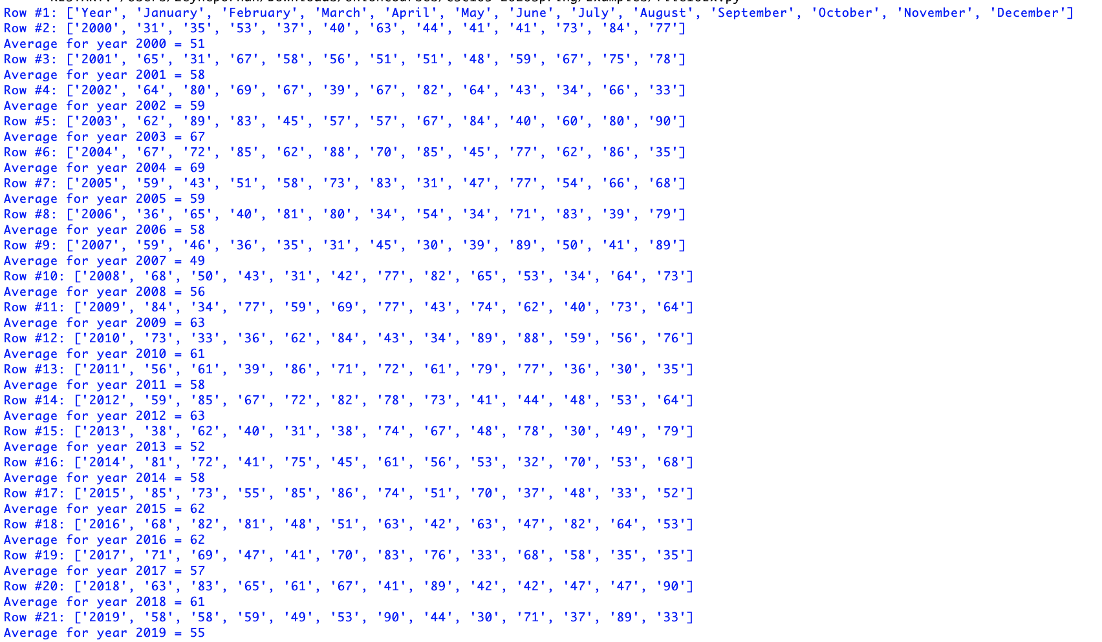
Processing the file: csv read

Slide 28
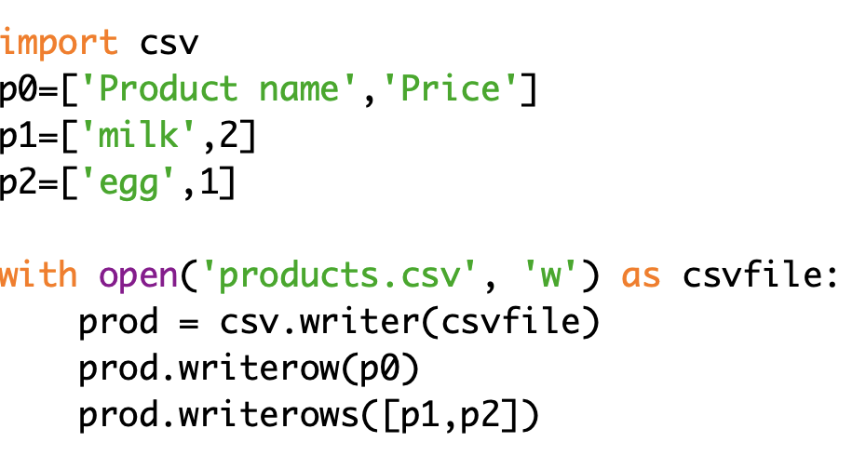
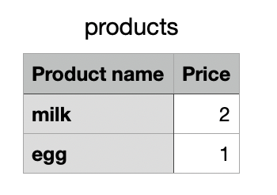
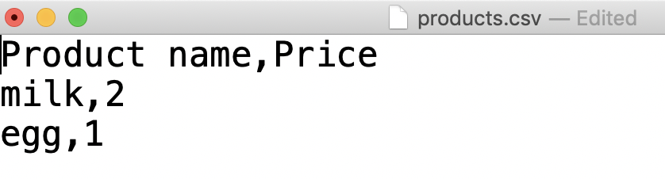
Processing the file: csv write
# with open('products.csv', 'w', newline = '') as csvfile:
# use the above for windows not to have extra spaces bw lines

Slide 29

DO NOT FORGET TO PRACTICE

Slide 30
CAN YOU FIND THE MONTHLY RAINFALL AVERAGES

Slide 31
CAN YOU FIND THE MONTHLY RAINFALL MAX AND MIN VALUES

Slide 32
CAN YOU FIND THE YEARLY RAINFALL MAX AND MIN VALUES

